Slide 1
Adaptive Artificial Foveal Vision
Derek Lee
ECE-472 Deep Learning
Professor Curro

Slide 2
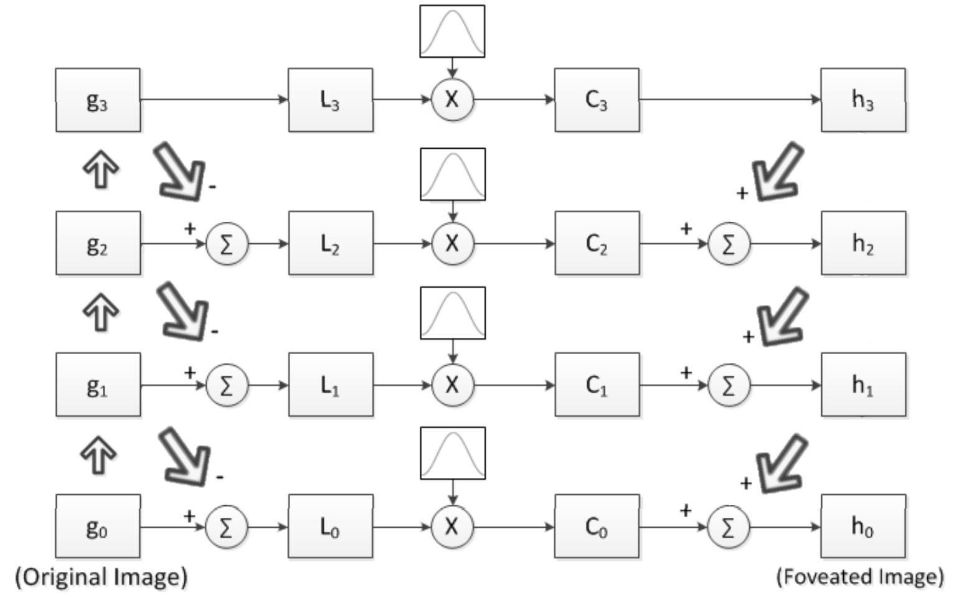
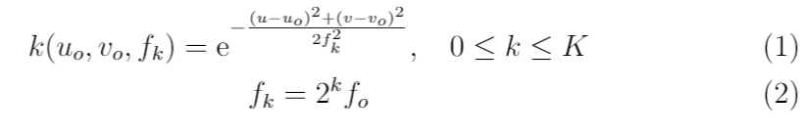
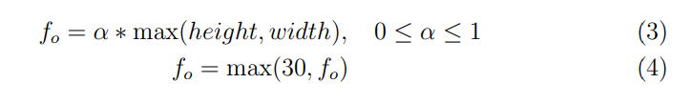
Foveation System
Thick Up Arrow: Downsample and Gaussian Blur Thick Down Arrow: Upsample

Slide 3
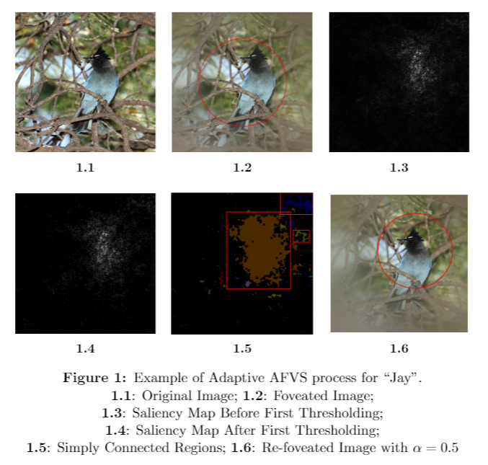
Adaptive AFVS Example

Slide 4
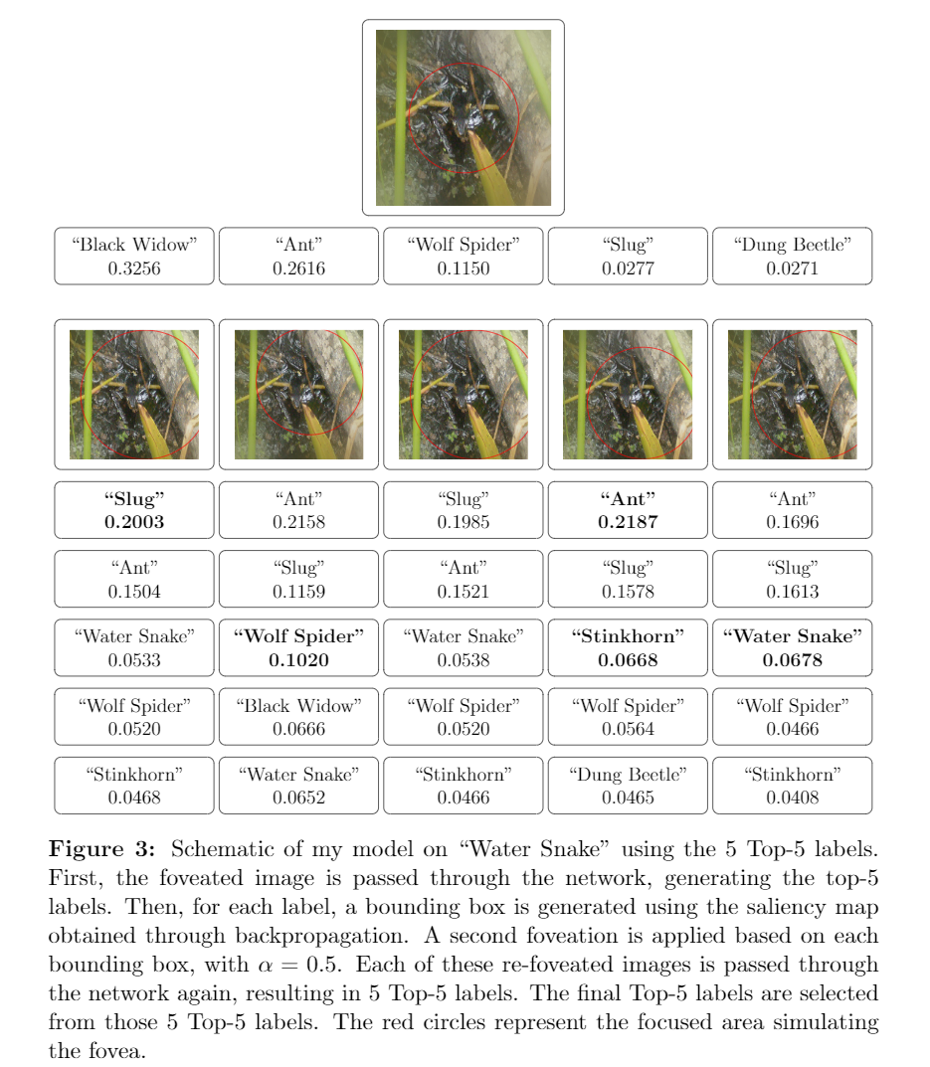
Schematic Example

Slide 5
Results

Slide 6
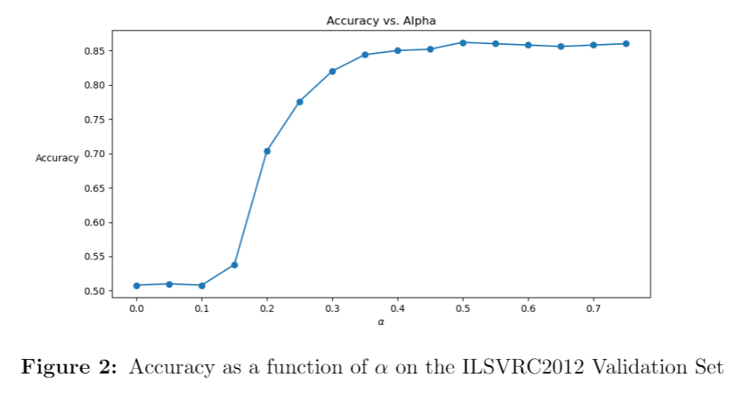

Slide 7
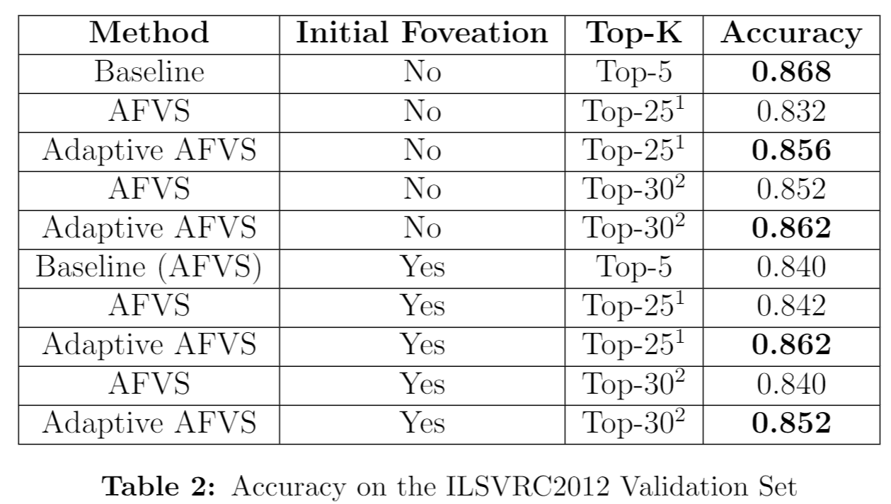

Slide 8
Shortcomings

Slide 9
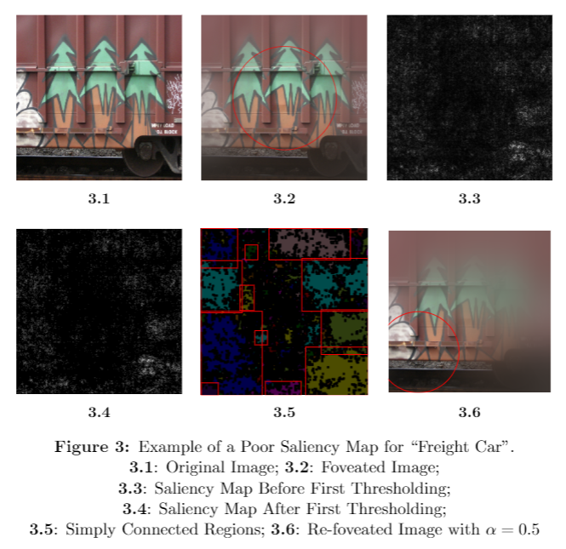
Poor Saliency Maps

Slide 10
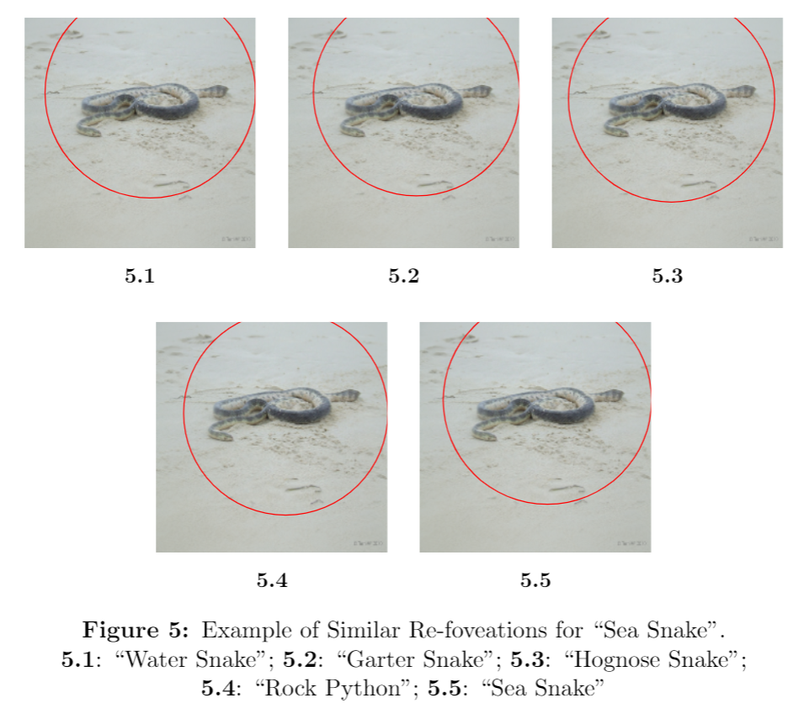
Similar Class Predictions

Slide 11
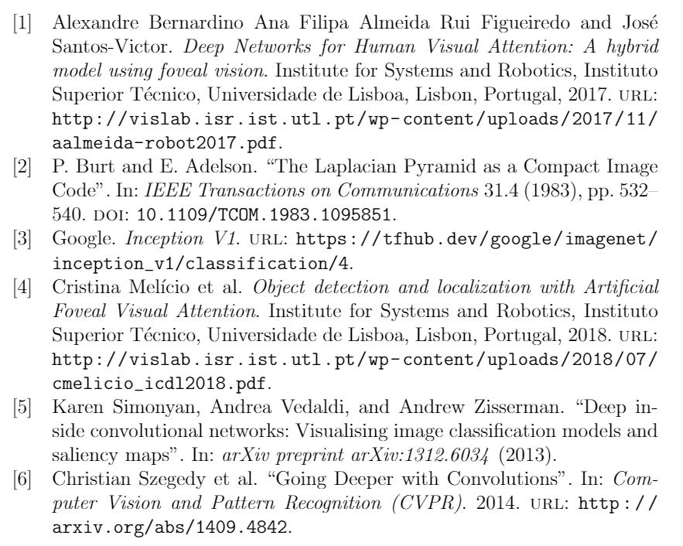
References

